Slide 1


Universal healthcare
path to effective, fairer and healthier world?
Addressed to:
Healthcare policymakers and Ministers in a WHO conference

Slide 2




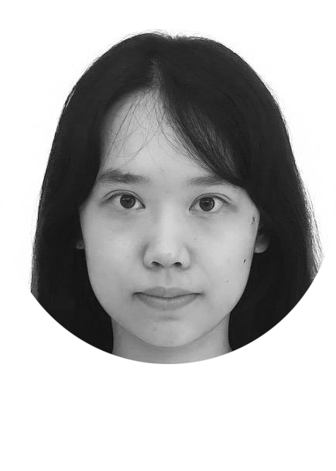

Meet the hexdata team
Jason
Alacapa
Nada
Khalid
Angeline
Victoriano
Healthcare professional,
Working in xx hospital
Clinical Lead and Senior Physiotherapist
Healthcare professional,
UCSF Medical Center
Dongxiao
Chen
Santhosh
Kumar
Dorothy
Lui
Bioinformatics Msc student
Child and youth development specialist
Consultant Radiologist

Slide 3
Universal health coverage everyone, everywhere

Slide 4

Can we eat a cake and have it too?
Safe, accessible and equitable
affordable
The healthcare system is easily acessible by individuals regardless of financial constraints
Healthcare body negotiating prices behalf of patients -> reduction in overall cost

Slide 5
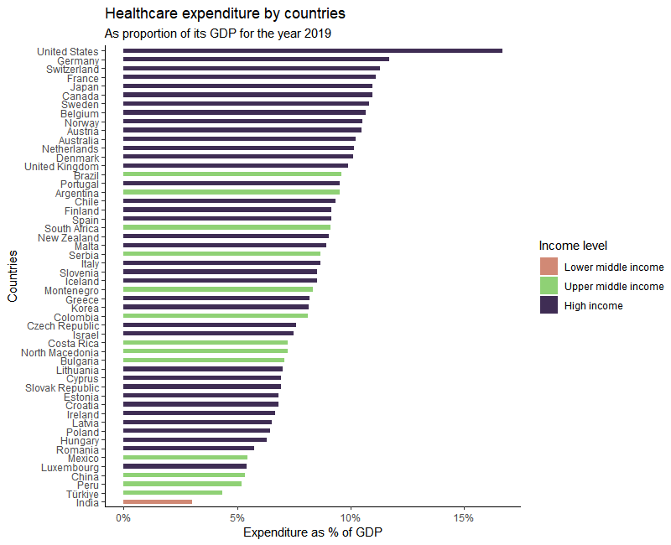
Notes:
Is there a way to optimize the spending to maximize health of individuals with every dollar spent?
Is there a correlation between healthcare utilisation and free access healthcare?

Slide 6
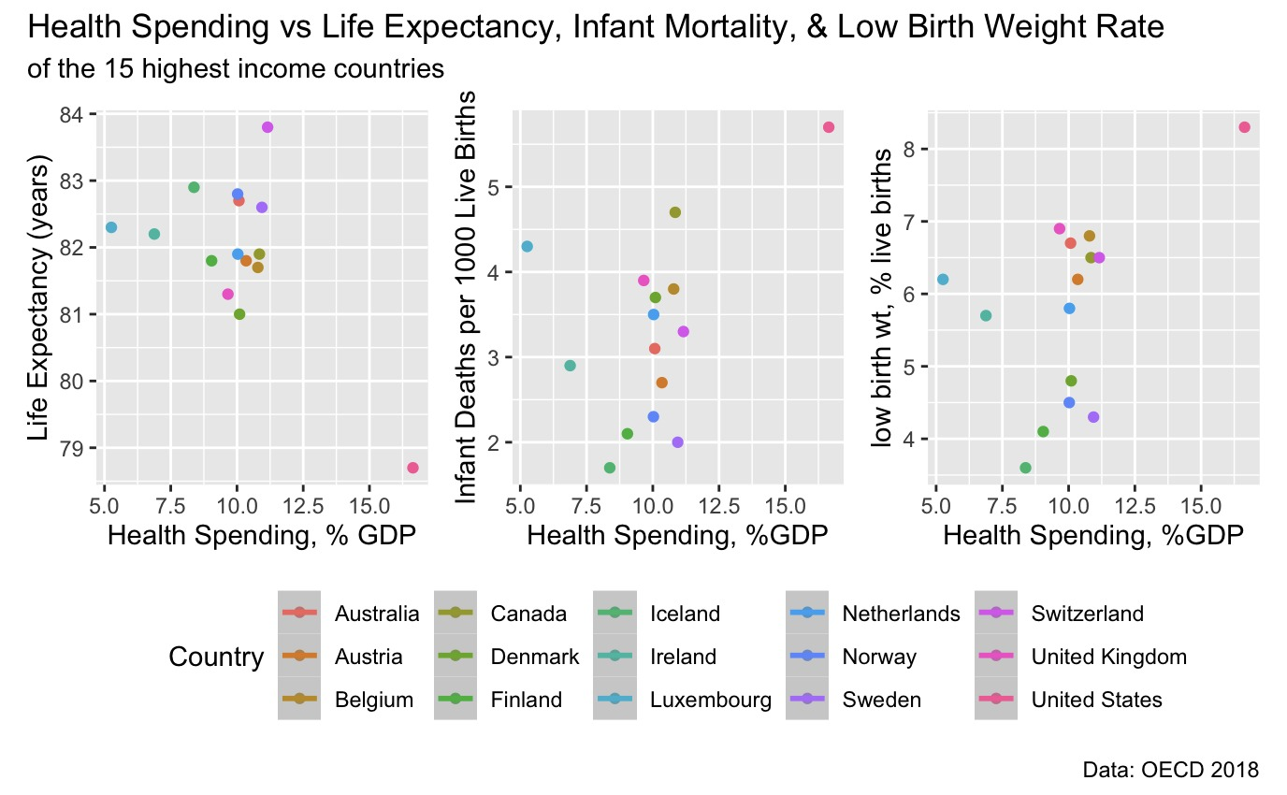
Increased SPENDING ≠ great HEALTHCARE OUTCOMES

Slide 7
Universal healthcare
Universal health care is where health care provided to all individuals regardless of gender, race, region, age, health status, income, or wealth. The state can provide universal health care in many ways, including the following:
Paying health care providers from a single organization (single payer)
Subsidizing coverage through the private sector
Providing vouchers or refundable tax credits to obtain health care
Also known as compulsory or state healthcare financing

Slide 8
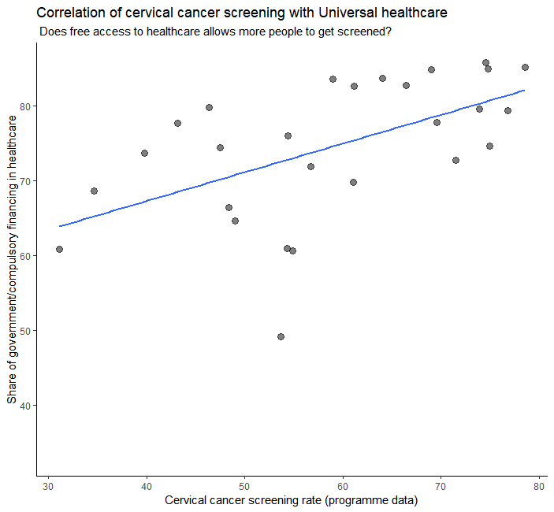
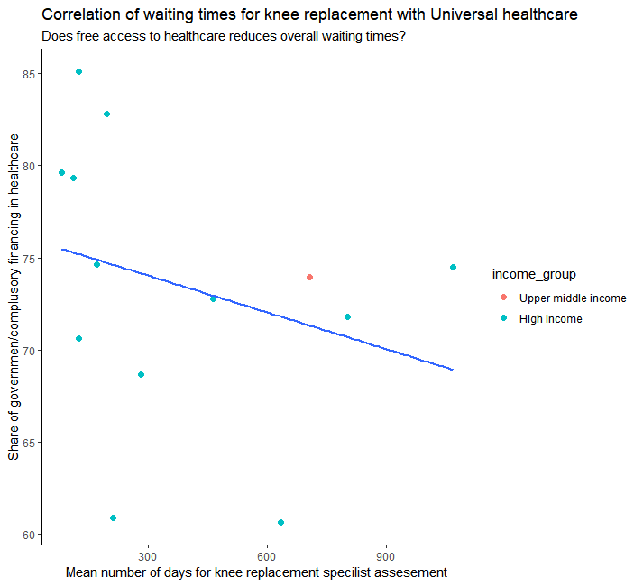
Impact on primary care and secondary care

Slide 9
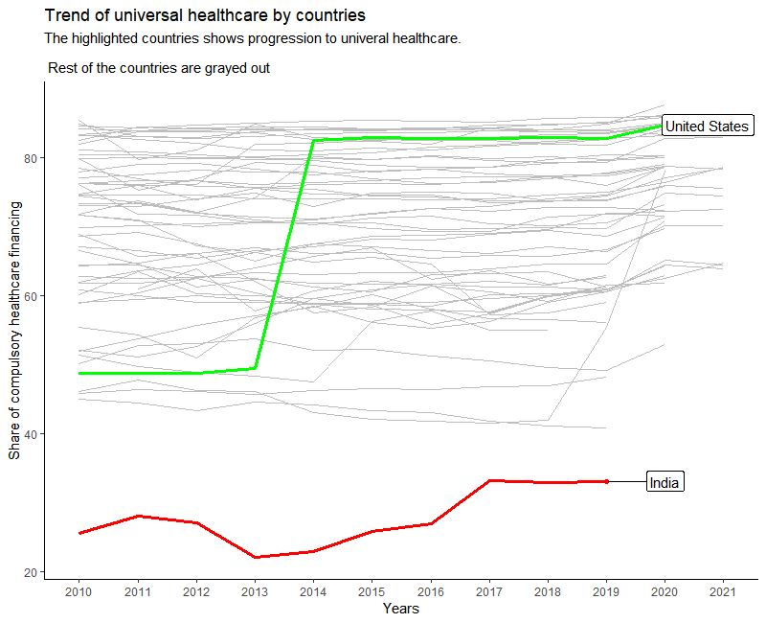
We are heading in right direction.
But we need to do more

Slide 10
“Health a fundamental human right and WHO commits to ensuring the highest attainable level of health for all”
—1948 WHO Constitution
Reference: World Health Organization, 1995. Constitution of the world health organization.

Slide 11
THANKS
CREDITS: This presentation template was created
By Slidesgo, including icons by Flaticon, and
infographics & images by Freepik

